Slide 1
Cyberspace and Health
Espen and Henrik

Slide 2
Medical Robots

Slide 3
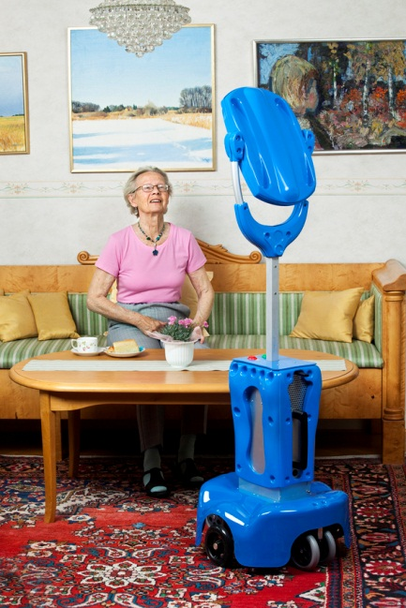
Vasteras Giraff
Mobile communication tool
Two way video calling (Skype)
Rigorous testing and feedback from end users

Slide 4
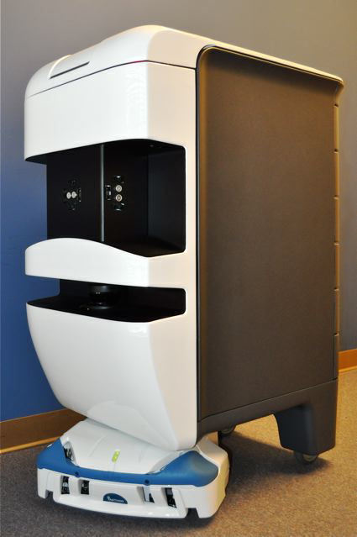
Aethon TUG
Automated system, moves supplies
Scheduled or on demand deliveries
Increased productivity
ROI (Return on investment)

Slide 5
Telemedicine and E-Health

Slide 6
Telemedicine
Broad range of medical services
Perform quality control remotely
Low tech, affordable solutions
CT-scans
Videoconferencing
Test for countless symptoms—even cancer

Slide 7
E-Health
Pharmacy (prescription database)
Medical Records(online)
Good:
Unique way of communicating
Security
Prevent forgery
Bad
Personal information risk
Downtime

